Slide 1
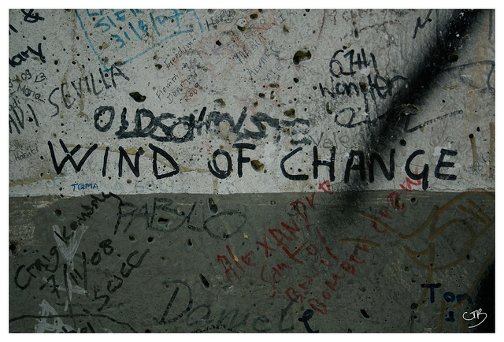
End of the Cold War

Slide 2
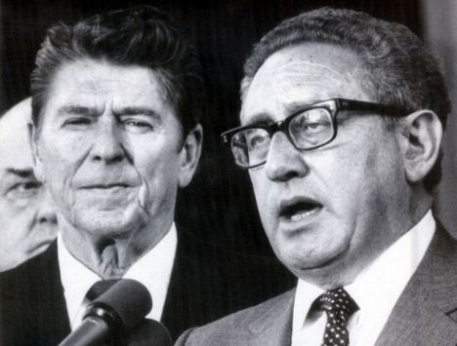
Why.
KISS: No world power had collapsed so quickly and definitively w/out a war until USSR (763)
Overextension of borders, military, economy
Leaders unwilling to face obvious domestic problems
Jeez, just get done
with it already – RR

Slide 3
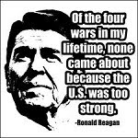
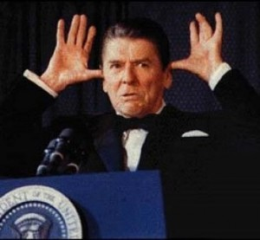
Ronald Reagan – Unlikely Hero
KISS: Knew just enough to get by on foreign policy, but had a leader’s sense of direction & strength of convictions (765)
Conceptually, same ideas as Nixon & Ford, but execution was better: use exceptionalism to drive FP
1983 – “Evil Empire” speech
Ended détente→ “crusade & conversion”
Fear of Armageddon brings USSR to table→ more direct conversation than any previous US President.

Slide 4
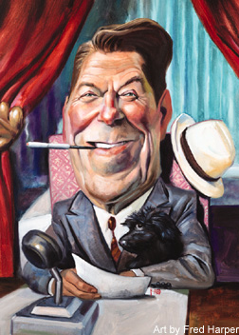
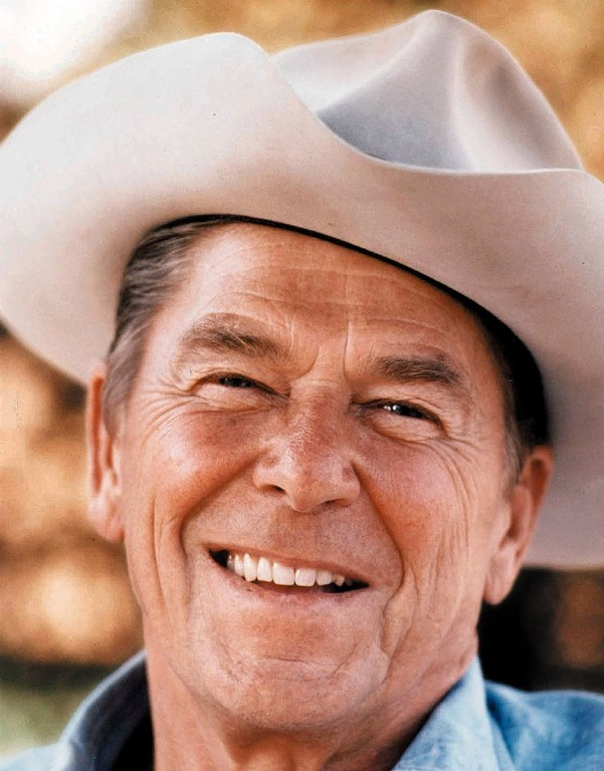
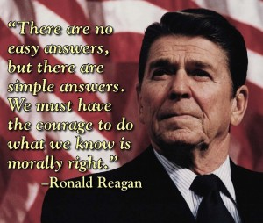
Reagan’s Goals
Pushes for final outcome through relentless confrontation (Machiavellian) (771 “Fantasy”)
First postwar president to take offensive ideologically & geostrategically→ Communism could be defeated
#1: Combat Soviet pressures until expansion stops
#2: Rearm to stop Soviet strategic superiority
KISS: Takes Wilsonianism to its ultimate conclusion by actively promoting democracy (773)

Slide 5
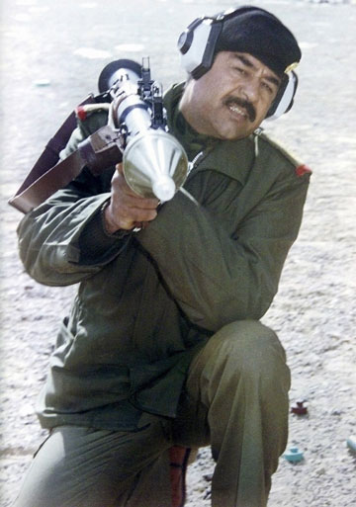
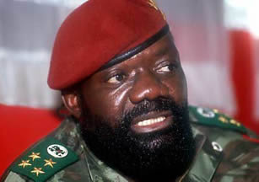
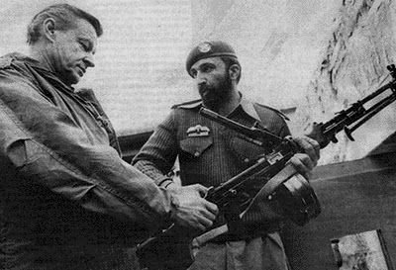
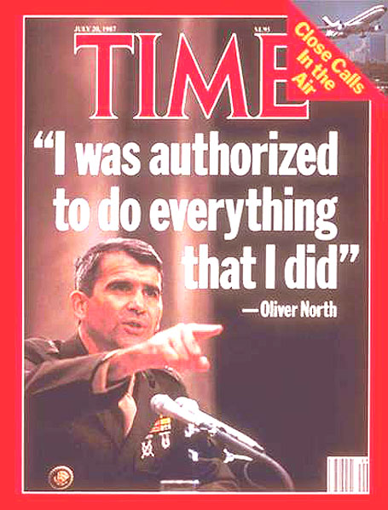
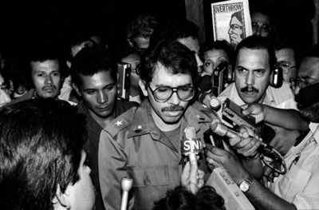
Reagan Doctrine
US would help anti-communist counter-insurgencies wrest their respective countries out of Soviet sphere
Armed forces in Angola, Afghanistan, Nicaragua, Iraq, & humanitarian aid in Cambodia
Helping them embodied Richelieu→ helping enemy of my enemy→ Similar to Truman Doctrine (774)

Slide 6
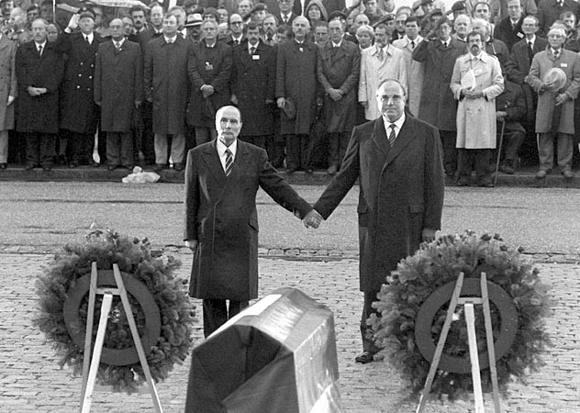
How to End a Cold War (775-82)
NATO deploys intermediate range missiles in EUR
Rebirth of US arms buildup
Bridges gap in deterrence
Moscow threatens to walk out of peace talks→ tries to become the side of peace in EUR against bellicose USA
Mitterand (FRA) & Kohl (GER) stand by US

Slide 7
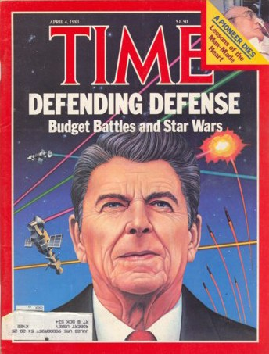
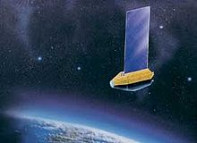

America’s commitment to Strategic Defense (SDI)
KISS: Topples balance of deterrence again in US favor
Majority of media/academics against it (779-80)
RR continues support on political grounds→ trying to bring about the abolition of nuclear war
Opposite Soviet reaction than what most predicted→ opened the door to arms control
KISS: Reagan’s paradox: wants to build arms, SDI in hope nuclear war never occurs, avoid Armageddon, but this is a signal he won’t use them (782)
Soviets can’t test this b/c they’re too weak

Slide 8
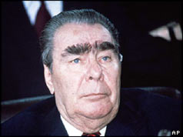
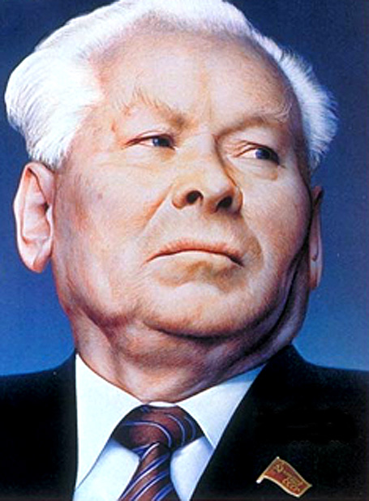
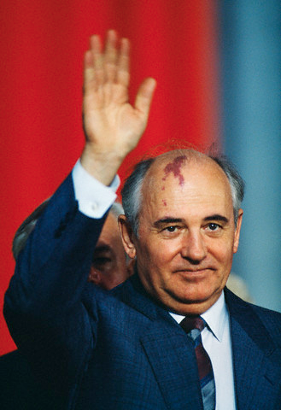
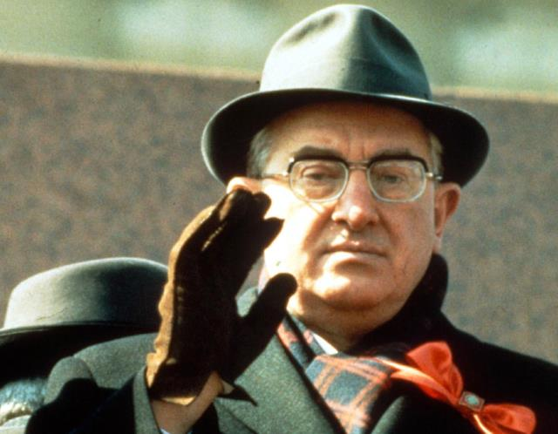
Soviet Transition
Brezhnev (dies ’82)→ Andropov (dies ’84)→ Chernenko (dies ’85)→ Mikhail Gorbachev

Slide 9
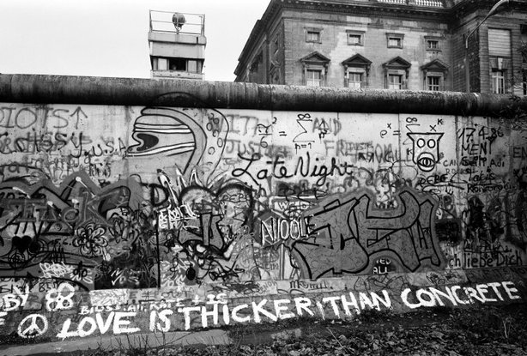
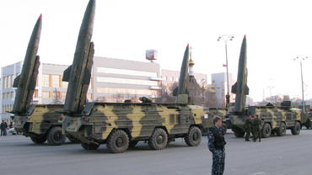
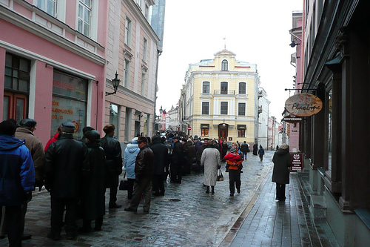
Soviet Problems (1985) (790)
Relations w/ West
Relations w/ CHN
Strains in satellite orbit
Renewed arms race
Stagnation of domestic econ/pol

Slide 10
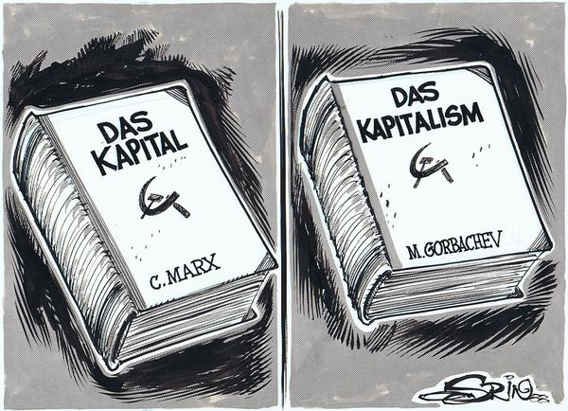
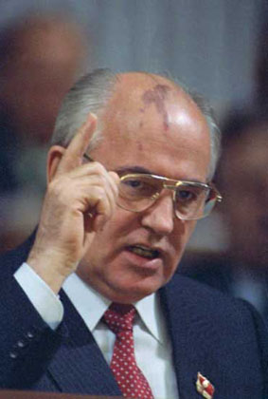
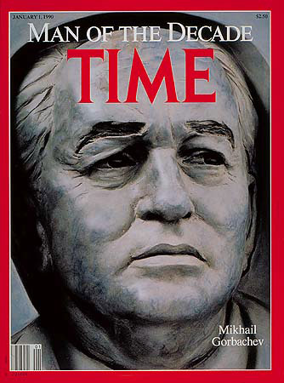
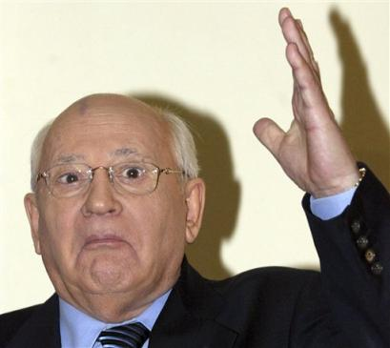
Mikhail Gorbachev (1985-91)
Personality: (785)
Made valiant effort to update strategy, get nukes out of GER, and weaken NATO (Common European Home) (791)

Slide 11
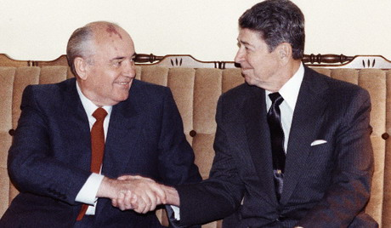
Reykjavik Summit (1986)
Agree in principle to reduce all strategic forces by 50% in 5yrs & destroy all ballistics in 10yrs.
Tough position for allies→ US & USSR making decision
BUT Gorby presses for end to SDI→ RR leaves room & cancels agreement.
Later, both dismantle 50% & agreements were reached to take missiles out of EUR
KISS: RR had turned what had been a marathon into a sprint (784); Couldn’t’ve sustained it without USSR collapse (785)

Slide 12
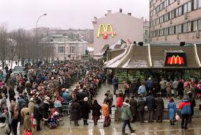
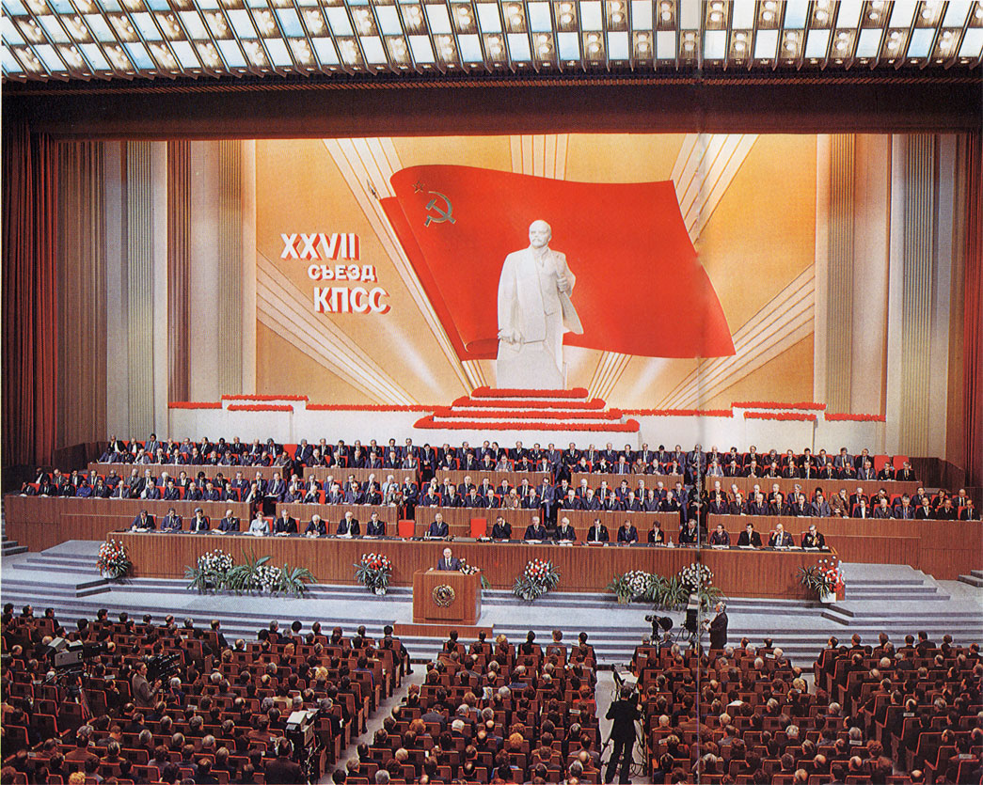
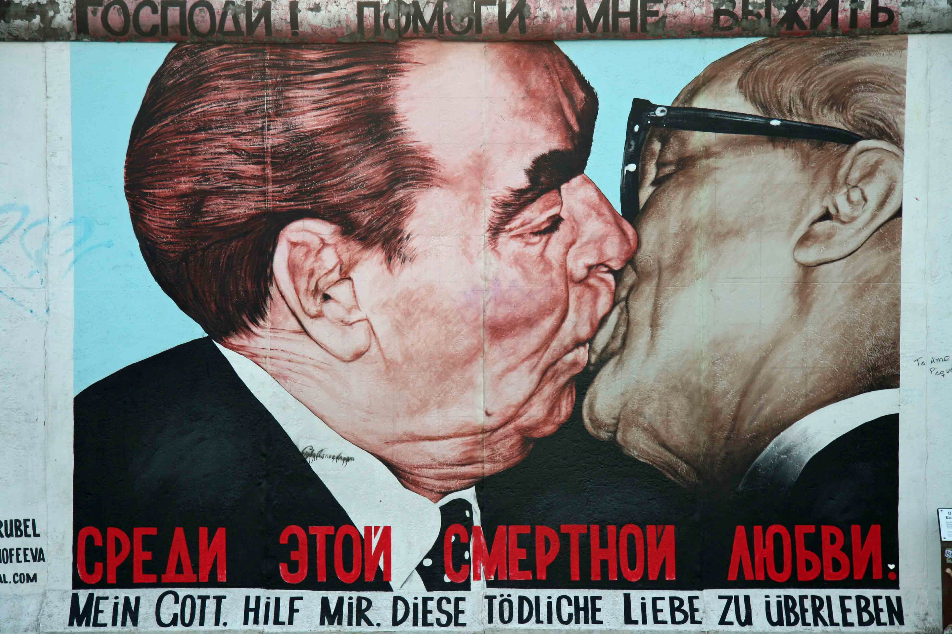
Glasnost & Perestroika (788-96)
G – Political liberalization & “Openness”→ gain intellectual support
P – Econ reform & restructuring to gain technocrats
1986 – 27th Party Congress – “New Thinking” – Gorby’s new approach to FP→ Wilsonian interdependence against Marx/Lenin (787-88)
Dec. ’88 @UN – Huge cuts to military; pacifies CHN w/leaving Mongolia (791)
KISS: Kennan right all along!
“God Help Me
to Survive this Deadly Love”

Slide 13
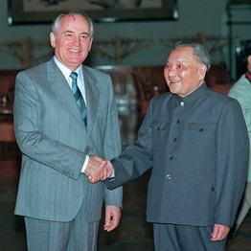
China
Gorby Extended peace & friendship in ’86 →
Get out of AFGH, tell VIE to get out of CAM, withdraw from Sino-Soviet border, then we’ll talk.
Bad luck: Tiananmen Square Riot/Massacre happened when Gorby arrived to negotiate (May ’89)

Slide 14
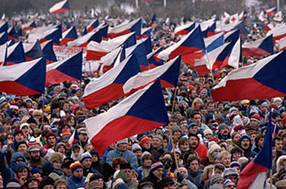
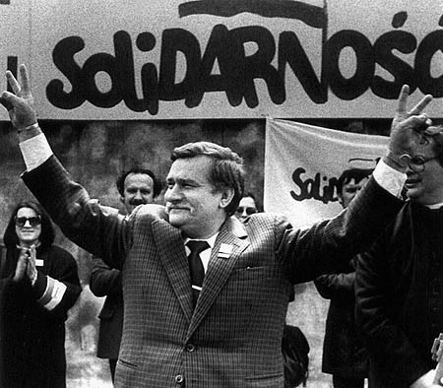
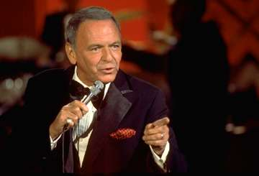
Eastern Bloc
Called for more nationalized, democratic reforms
Gorby couldn’t invoke Brezhnev Doctrine b/c of all his improvements w/ NATO→ abandons it entirely by 1989 in favor of “Sinatra Doctrine”
KISS: Liberalization proved incompatible with communist rule (794)

Slide 15
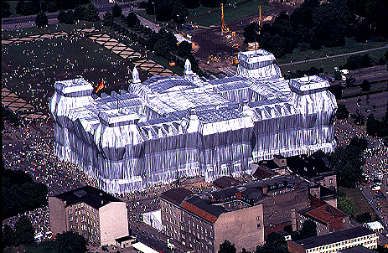
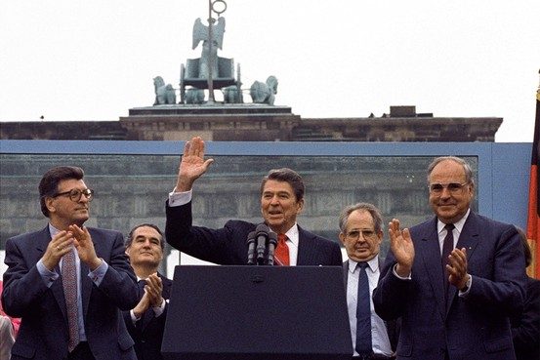
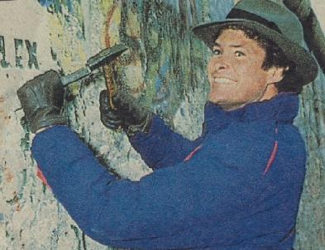
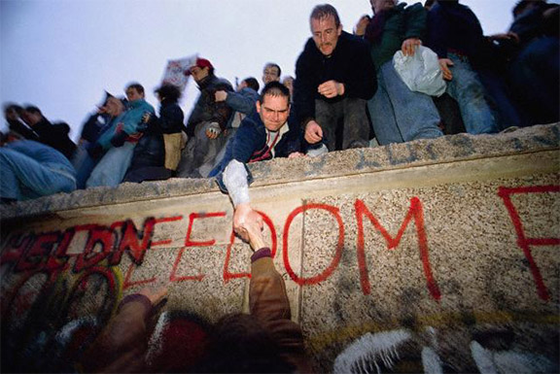
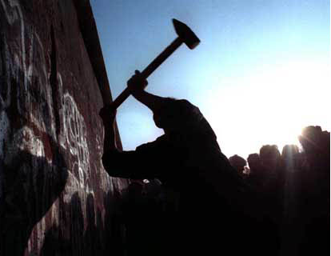
Mr. Gorbachev, Tear Down This Wall
Nov. 1989 – Wall Falls→ 1990 – Reunified GER in NATO→ Every communist gov. overthrown in Bloc → Warsaw Pact is dead.

Slide 16
How did We Get to 1991? (787)
USSR’s only allies in E. EUR after CHN leave & they’re more of a drain than a help
3rd World exploits costly & inconclusive
US arms buildup, SDI too costly to compete with
Gorby’s gambles fail (795-96)
Liberalization would modernize USSR
Then, USSR could hold onto Superpower status
Liberal communism doesn’t work (796)
Neither G or P work b/c infrastructure for freedom didn’t exist→ “Over 25, wasted your life.” (797)
Shift of power from Party to regional entities→ “Army of clerks”; “Sins of Russian history came home to roost” (798)

Slide 17
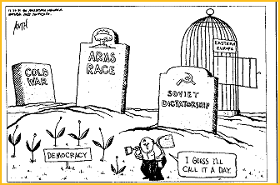
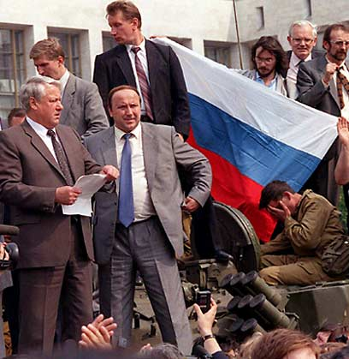
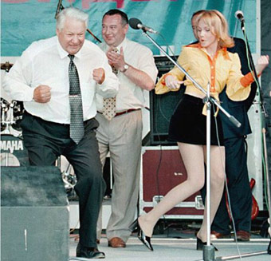
Fall of Gorbachev
KISS: Too fast & too slow (799)
1990 – Baltics secede, the the rest fall
12/25/1991 – Coup attempt by army & Boris Yeltsin in ’91→ Fails, but Russia declares independence.
West liked him so much, they defended legality of communist constitution that put him in office (786)
Jan. 1992 – Gorby forced to resign→ W. to Yeltsin

Slide 18
Was the USSR ever really a threat?
Victory by idea of democracy (799)
Marxists (Halliday) (800)
Soviet Revisionists (Dashichev) (800)
Shevardnadze (801)
Looking back to Kennan (801)
Kissinger: No. (799 & 802-803)

